Slide 1







2024 GitHub Presentation Template
Enterprise
Security
Productivity
Collaboration
AI

Slide 2

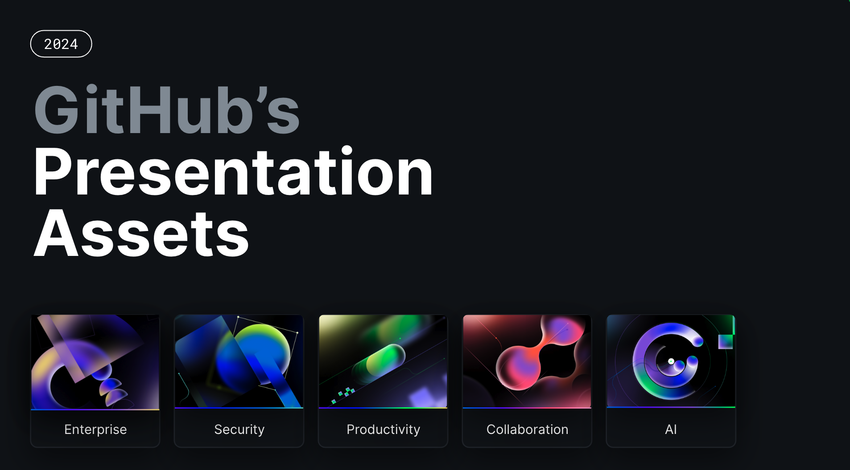
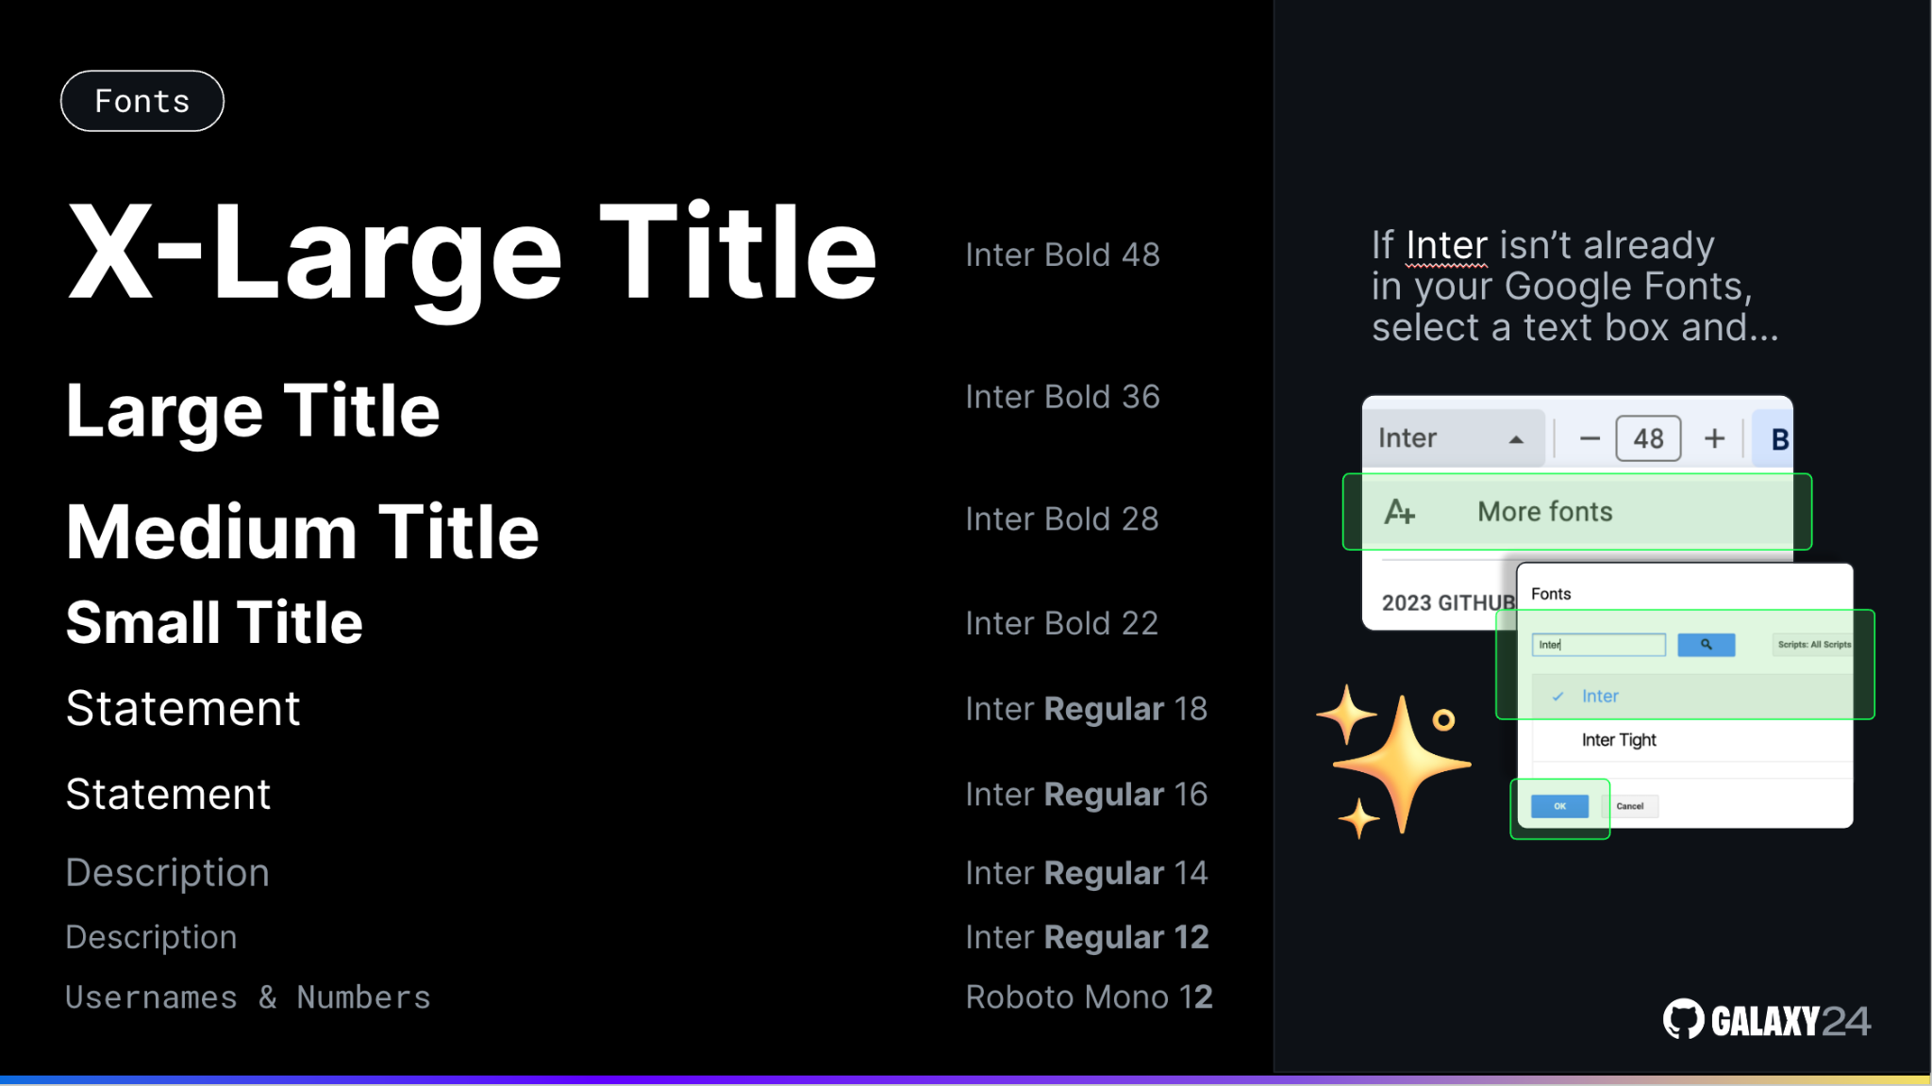
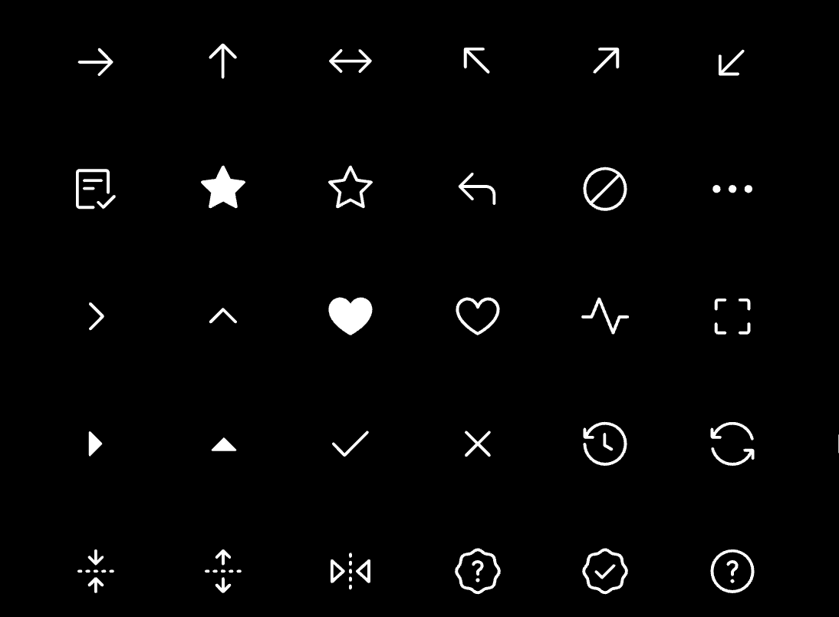
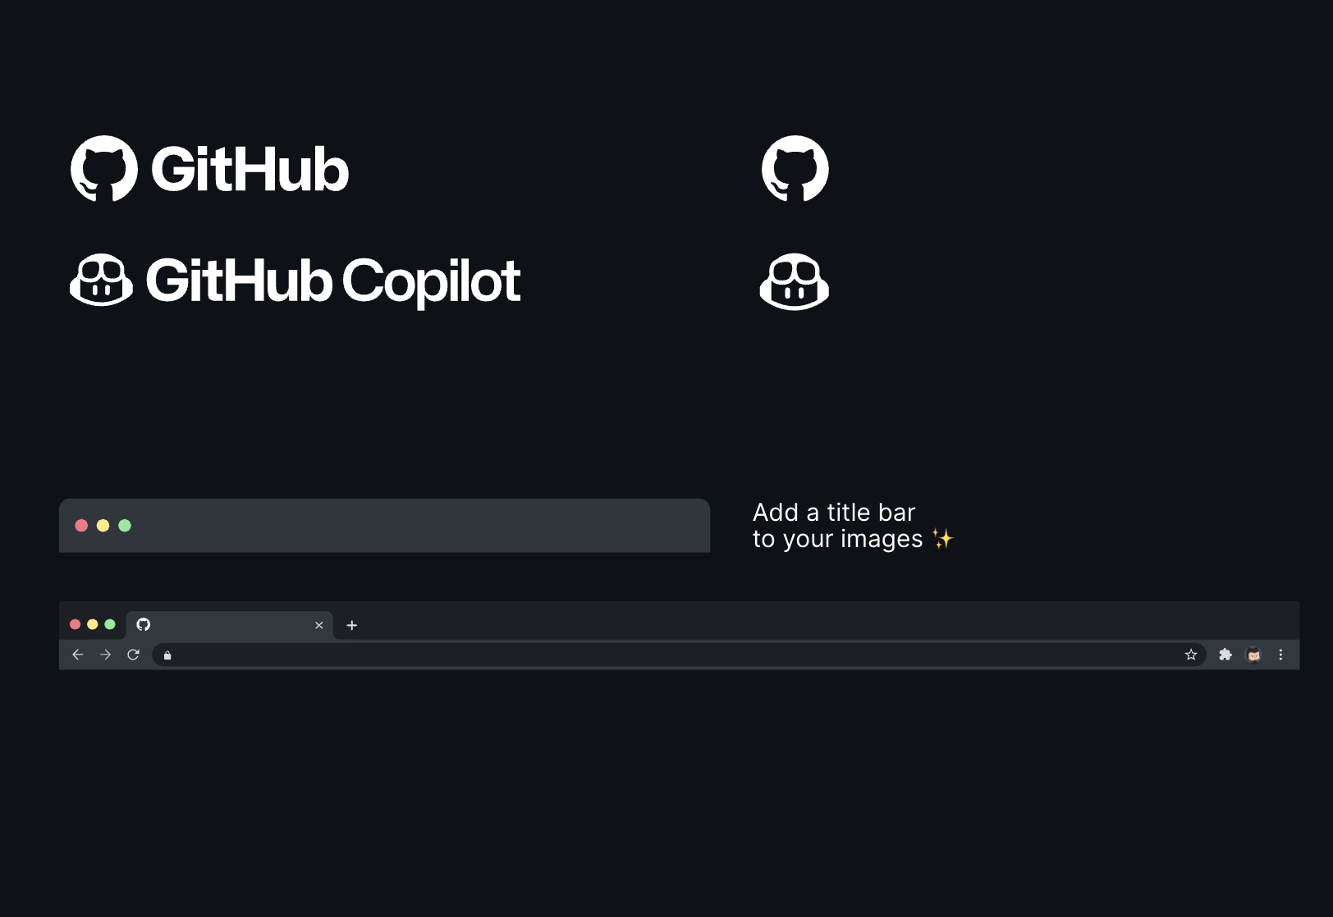
Presentation tools
Fonts
Octicons
Additional assets
Check out the following slides for these presentation tools & guidelines
Click here for GitHub pillar presentation assets to sprinkle some magic into your slides 🌟

Slide 3
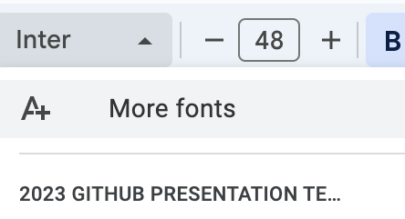
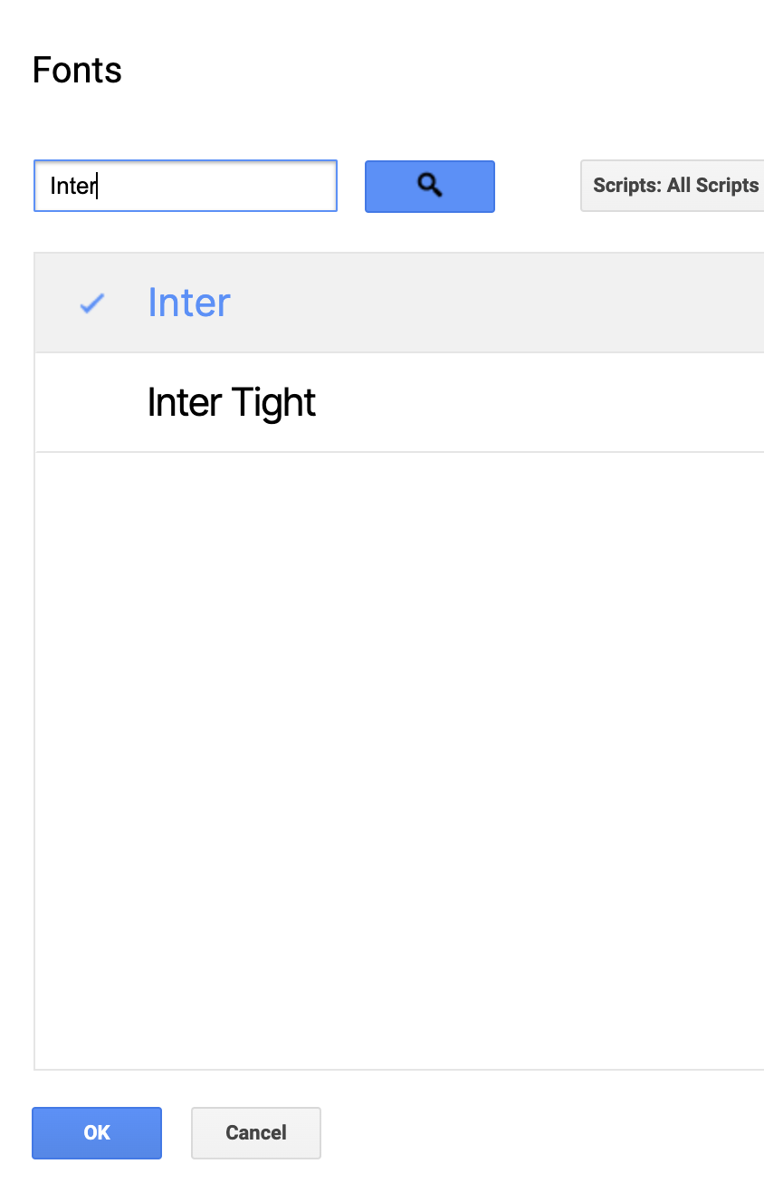

X-Large Title
Inter Bold 48
If Inter isn’t already in your Google Fonts, select a text box and…
Large Title
Inter Bold 36
Medium Title
Inter Bold 28
Small Title
Inter Bold 22
Statement
Inter Regular 18
Statement
Inter Regular 16
Description
Inter Regular 14
Description
Inter Regular 12
Usernames & Numbers
Roboto Mono 12
Fonts

Slide 4


Please do
Please don’t
Octicons
In the following slides, you will have access to our vector Octicon Library, which you can use throughout your presentation!
The icons are vectors which means you can change the colors (remaining within the provided GitHub Universe brand colors)
The icons are already properly sized. Please refrain from resizing them.

Slide 5
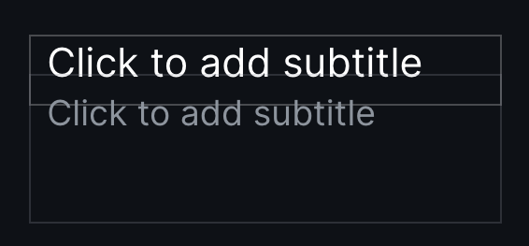
Octicons
When you see text boxes like this…
Add an icon above to visually represent your information!
And don’t forget to play with color!
You’re doing great
You’re doing great
Keep it up!
Keep it up!

Slide 6
People

Slide 7
Objects

Slide 8
Symbols

Slide 9
Symbols

Slide 10
Developer

Slide 11





















MONAMOJIS
FOR INTERNAL USE ONLY!
…if you use the monamojis for external/public facing presentations

Slide 12
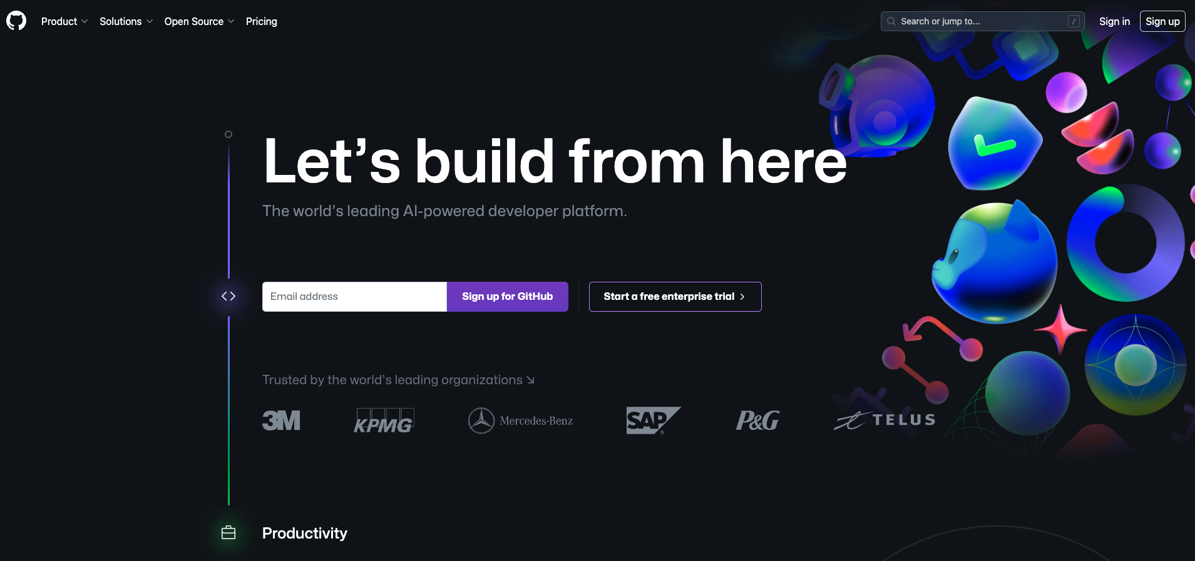
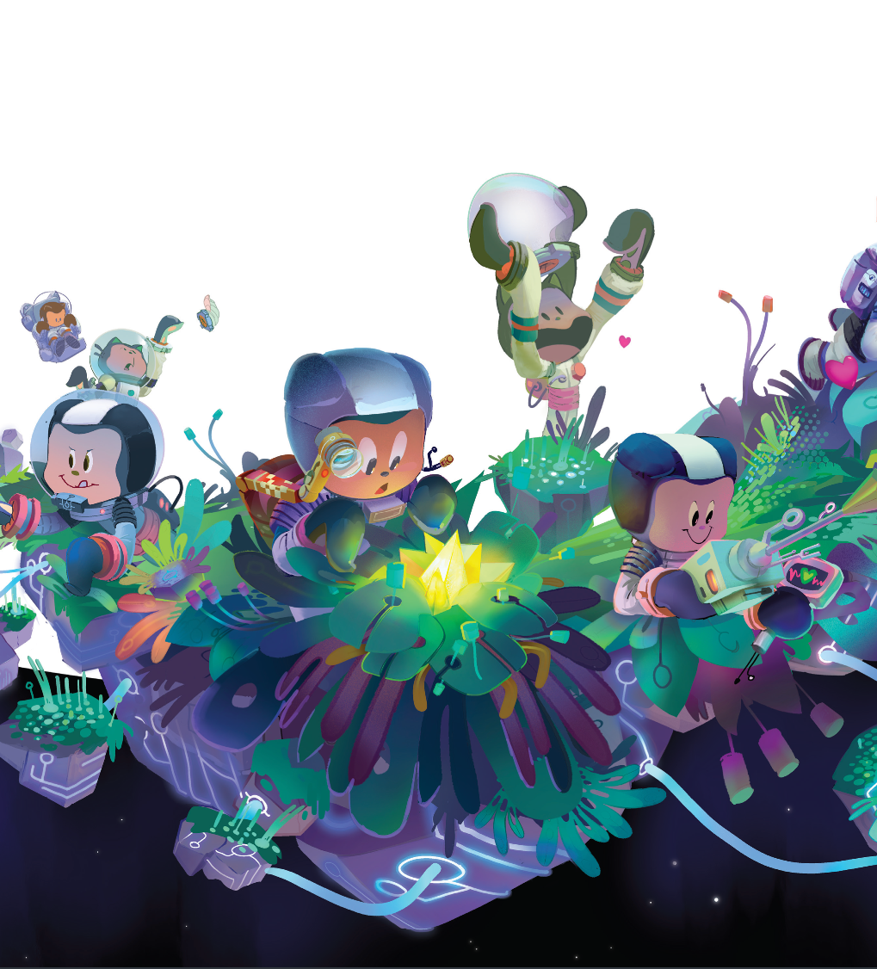
Title bars
Add a title bar to your images ✨
Add a browser bar to your screenshots! ✨

Slide 13
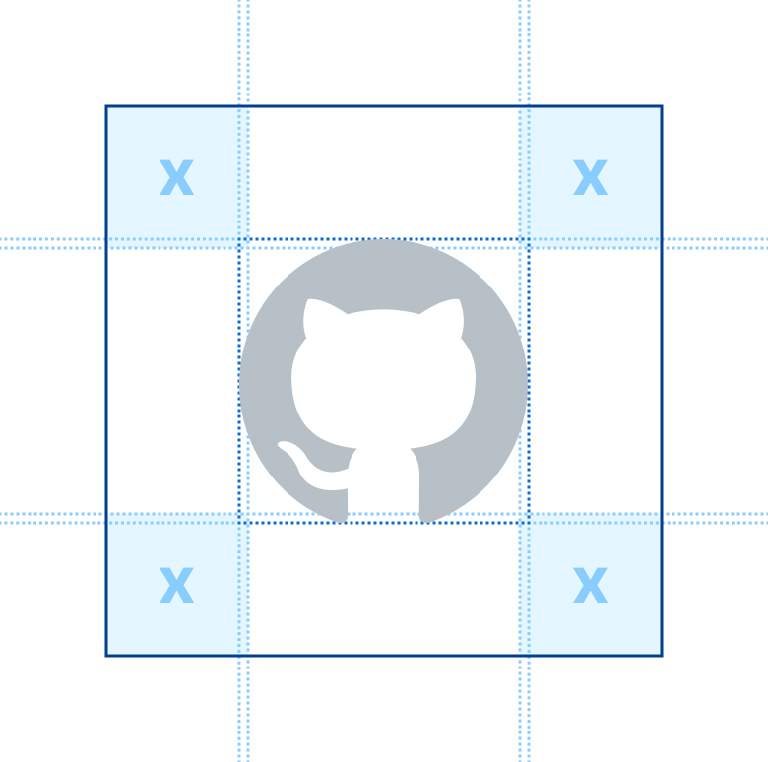
Logos
All logos have a certain amount of breathing space. The “x” represents the space our logo should have when used next to any other element, such as: text, logos, icons, etc. 💬

Slide 14
We want your feedback
Our goal is to offer you a template which makes it simple to create a beautiful, GitHub branded presentation. Tell us if we succeeded or if there are ways we can improve this tool for you! Any questions or suggestions are welcome 💖
Feedback survey

